Slide 1
Adding an Event to Google Calendar (with possible attachments)
L. Lindsey – 3/16/19

Slide 2
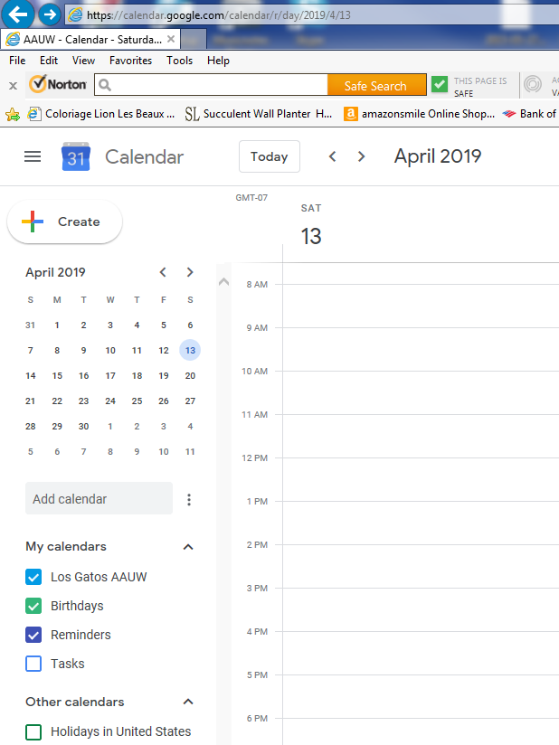
First navigate to the date you want to create the event, then click on “Create”.

Slide 3
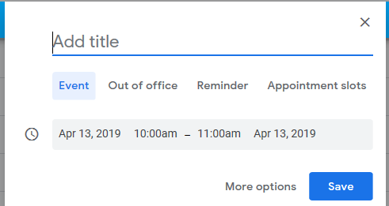
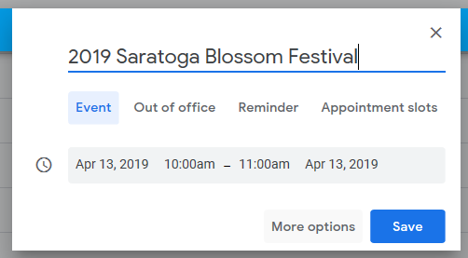
The following dialog box pops up after clicking on “Create”
Fill in the title and the time (if necessary) and then click on
“More Options”

Slide 4
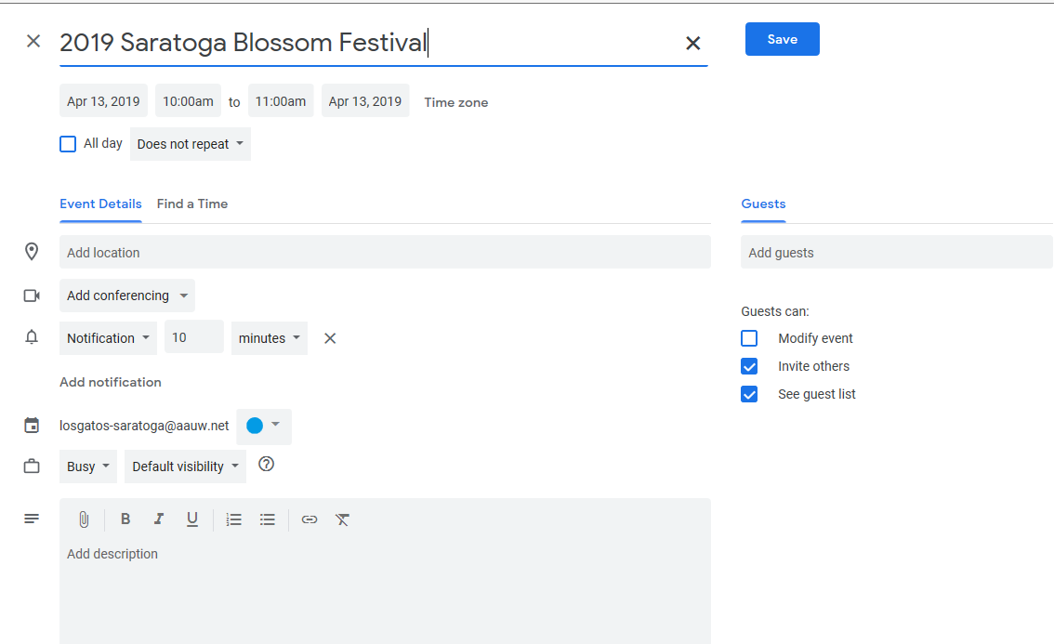
This dialog box comes up. Some fields are filled in automatically, but you may want to adjust the time, location, etc.

Slide 5
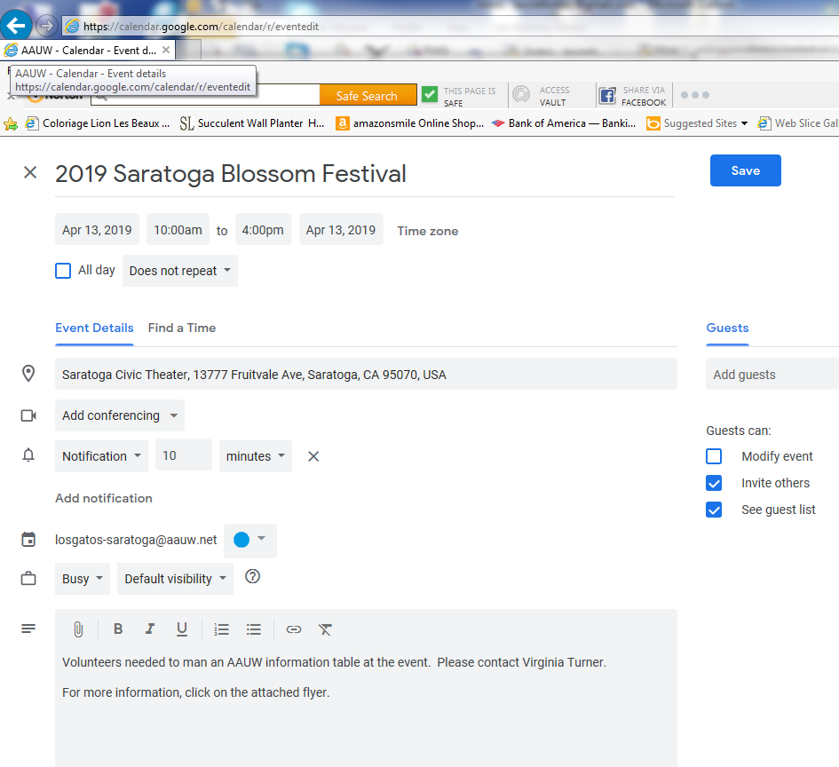
Fill in location. If the location is a public venue, you can start typing and Google will automatically fill in the rest.
(but beware, sometimes it doesn’t find what you want – as in this case, so I had to modify it.
You can modify the title if necessary
To add an attachment, click on this paperclip icon
Describe the event

Slide 6
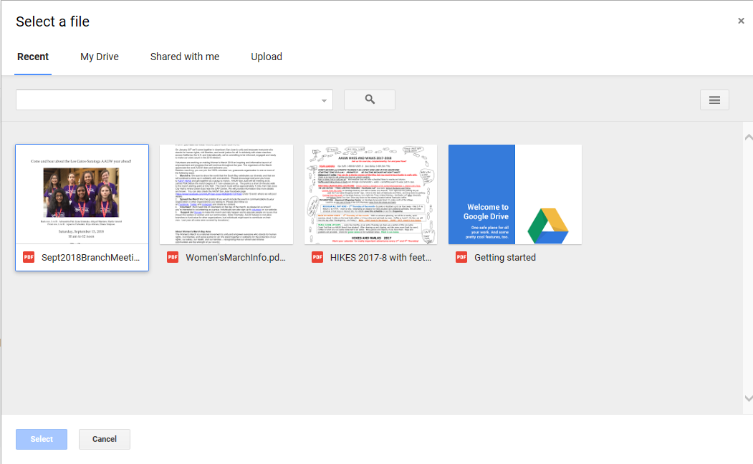
Click on the Upload tab to upload a new file. These files are placed on a “Google Drive”, which comes with our Google Calendar

Slide 7
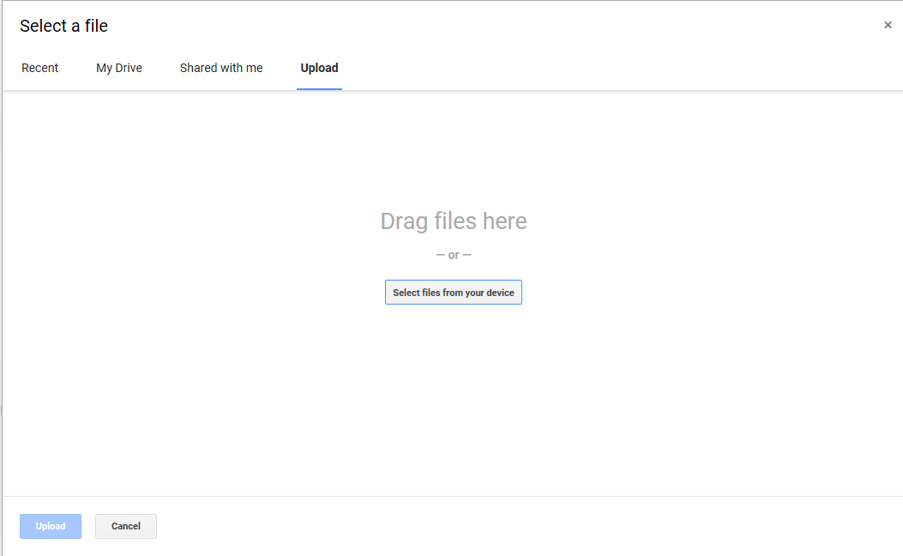
Just drag the file you want to upload to this window.

Slide 8
After you see your file(s) appear, click on the “upload” button at the bottom of that window

Slide 9
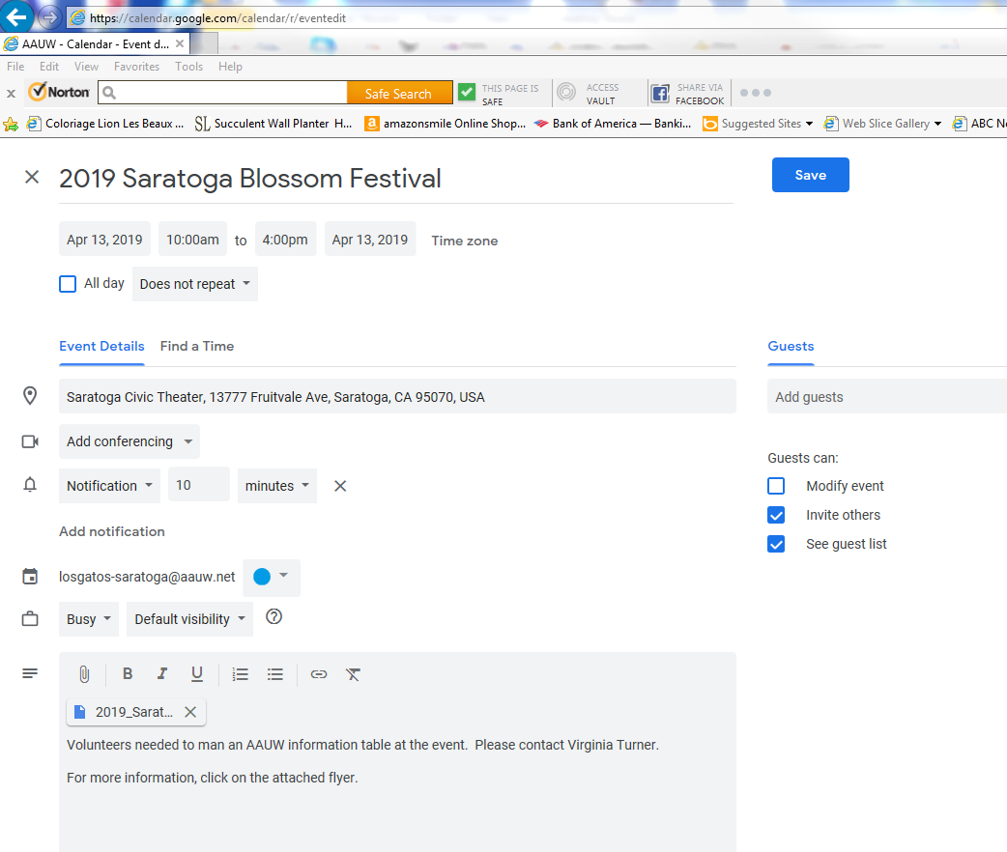
The attachment is shown here.

Slide 10
Click on “Save” to save the event.

Slide 11
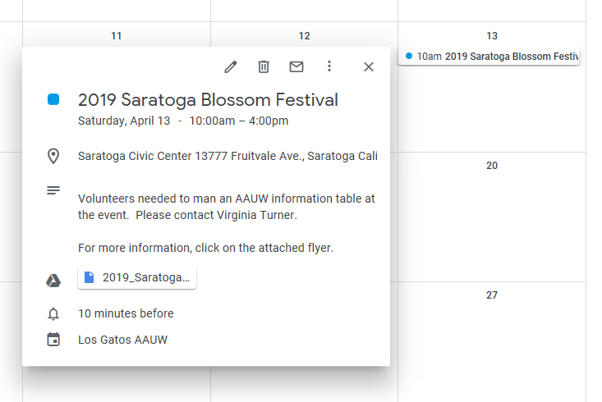
This is what the user will see when she clicks on the calendar event.
This is the attachment, and clicking on it will bring up the flyer.

Slide 12
